Slide 1
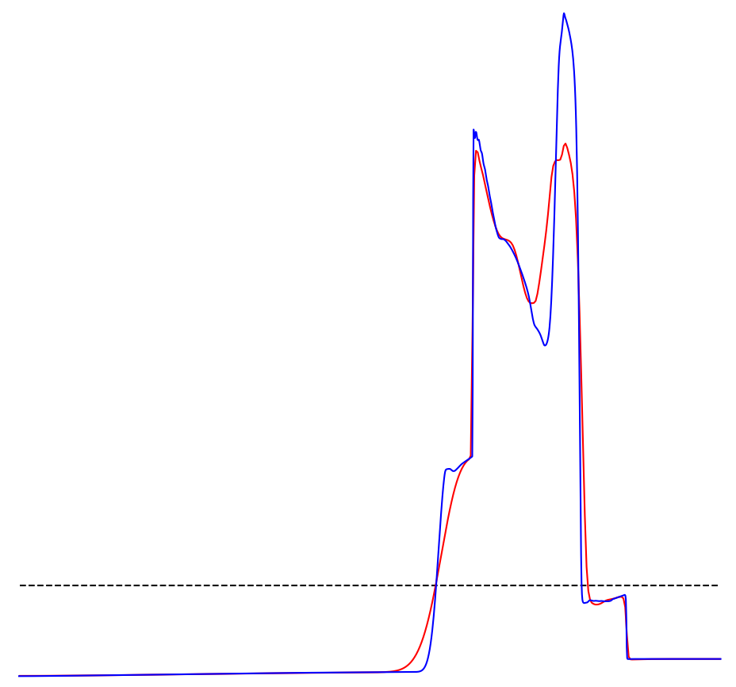
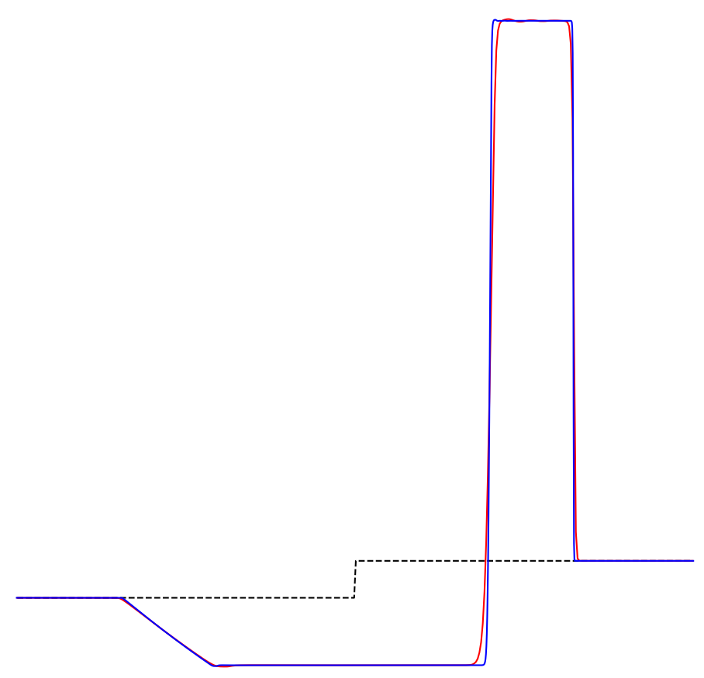
Numerical schemes for time dependent compressible euler equations of gas dynamics
Part-I of Bachelor Thesis Project
Lakshya Bamne (20MA20029)
Presentation on Literature Review and Introduction
Under supervision of Dr. Naveen Kumar Garg

Slide 2
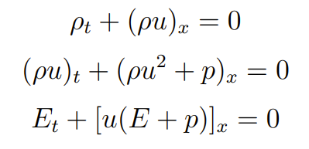

Euler Equations of Gas Dynamics
Govern the dynamics of a compressible material.
It is a system of nonlinear hyperbolic PDEs.
Numerical solutions for this system finds useful applications in the fields of Aerospace engineering and Computational Fluid Dynamics.

Slide 3
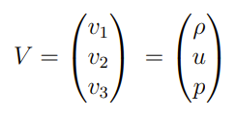
How to classify the system?
In order to classify the system we must convert it to it’s Quasi Linear form and observe the eigenvalues and eigenvectors for the Flux Jacobian.

Slide 4
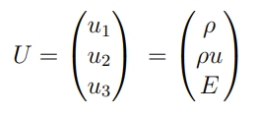
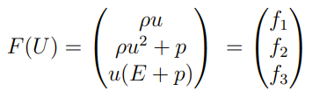
How to classify the system?
In order to classify the system we must convert it to it’s Quasi Linear form and observe the eigenvalues and eigenvectors for the Flux Jacobian.

Slide 5
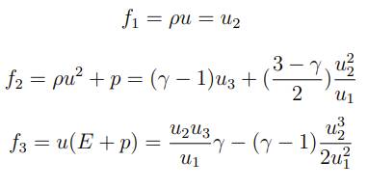

How to classify the system?
In order to classify the system we must convert it to it’s Quasi Linear form and observe the eigenvalues and eigenvectors for the Flux Jacobian.

Slide 6
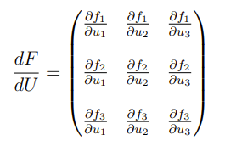
Flux Jacobian
Since the matrix has distinct eigenvalues, the eigenvectors must be linearly independent, this also means the system is hyperbolic.
Note the maximum and the minimum eigenvalues here which also signify the speed of information travel.
As a rule of thumb, whenever information travels at a finite speed, it is modelled using hyperbolic conservation laws.

Slide 7
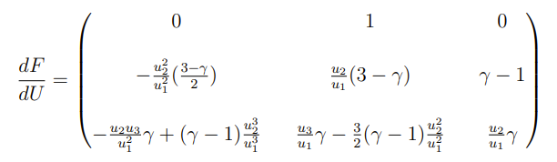
Flux Jacobian
Since the matrix has distinct eigenvalues, the eigenvectors must be linearly independent, this also means the system is hyperbolic.
Note the maximum and the minimum eigenvalues here which also signify the speed of information travel.
As a rule of thumb, whenever information travels at a finite speed, it is modelled using hyperbolic conservation laws.

Slide 8


Flux Jacobian
Since the matrix has distinct eigenvalues, the eigenvectors must be linearly independent, this also means the system is hyperbolic.
Note the maximum and the minimum eigenvalues here which also signify the speed of information travel.
As a rule of thumb, whenever information travels at a finite speed, it is modelled using hyperbolic conservation laws.

Slide 9
Euler Equations (Nonlinear Hyperbolic system of conservation laws)
Conservative Formulation

Slide 10
Euler Equations (Nonlinear Hyperbolic system of conservation laws)
Conservative Formulation
For solutions containing discontinuities like shock waves, this formulation is easier to build numerical schemes with.

Slide 11
Euler Equations (Nonlinear Hyperbolic system of conservation laws)
Non Conservative Formulation
Conservative Formulation
For solutions containing discontinuities like shock waves, this formulation is easier to build numerical schemes with.

Slide 12
Euler Equations (Nonlinear Hyperbolic system of conservation laws)
Non Conservative Formulation
Conservative Formulation
For solutions containing discontinuities like shock waves, this formulation gives wrong results.
For solutions containing discontinuities like shock waves, this formulation is easier to build numerical schemes with.

Slide 13
Euler Equations (Nonlinear Hyperbolic system of conservation laws)
Non Conservative Formulation
Conservative Formulation
For solutions containing discontinuities like shock waves, this formulation gives wrong results.
For smooth solutions, both formulations are equivalent.
For solutions containing discontinuities like shock waves, this formulation is easier to build numerical schemes with.

Slide 14

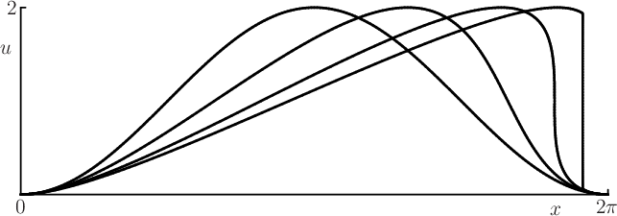

Hyperbolic PDEs are very sensitive to initial conditions
This is demonstrated by the Inviscid burger’s equation which is a first order nonlinear PDE.
Numerical solutions for such an equation are very sensitive to initial conditions and have a tendency to develop discontinuities even with perfectly smooth initial conditions (like a sine wave).

Slide 15
Semi-discrete central upwind scheme (CU Scheme)
CU Scheme is a well established finite volume scheme which is used to find numerical solutions for the Euler Equations of Gas Dynamics.

Slide 16
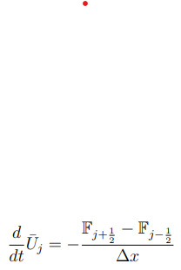
Semi-discrete central upwind scheme (CU Scheme)
CU Scheme is a well established finite volume scheme which is used to find numerical solutions for the Euler Equations of Gas Dynamics.

Slide 17
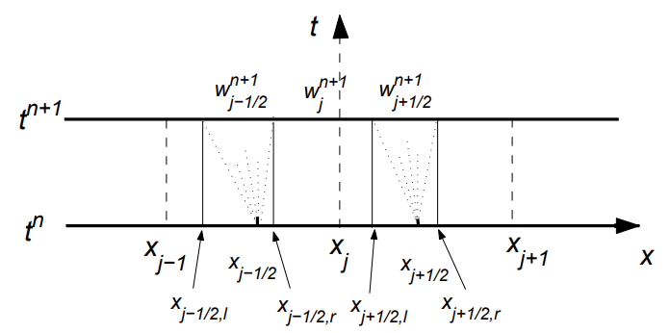
Semi-discrete central upwind scheme (CU Scheme)
CU Scheme is a well established finite volume scheme which is used to find numerical solutions for the Euler Equations of Gas Dynamics.

Slide 18

Calculating the CU Numerical Flux

Slide 19
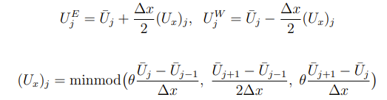
Calculating the CU Numerical Flux

Slide 20

Calculating the CU Numerical Flux

Slide 21
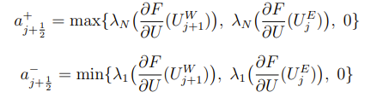
Calculating the CU Numerical Flux

Slide 22
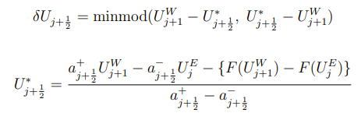
Calculating the CU Numerical Flux

Slide 23
Time Discretization and CFL Conditions
In order to discretize the LHS for the Finite volume scheme, we can use the Euler’s Forward Differences.

Slide 24
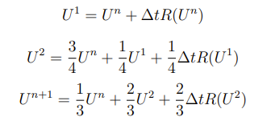

Time Discretization and CFL Conditions
In order to discretize the LHS for the Finite volume scheme, we can use the Euler’s Forward Differences.
But for more accuracy we have used the Three Stage Strong Stability Preserving Runge Kutta Time Discretization.

Slide 25
Courant-Friedrichs-Lewy Stability Conditions
Since we are dealing with a dynamic system where information is travelling at a finite speed, there is a bound on the time steps based on the cell sizes.

Slide 26
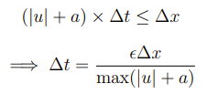
Courant-Friedrichs-Lewy Stability Conditions
Since we are dealing with a dynamic system where information is travelling at a finite speed, there is a bound on the time steps based on the cell sizes.

Slide 27
Courant-Friedrichs-Lewy Stability Conditions
Since we are dealing with a dynamic system where information is travelling at a finite speed, there is a bound on the time steps based on the cell sizes.
The maximum speed to information travel is the highest eigenvalue of the Flux Jacobian of the Euler Equations in the Quasi Linear Form.

Slide 28
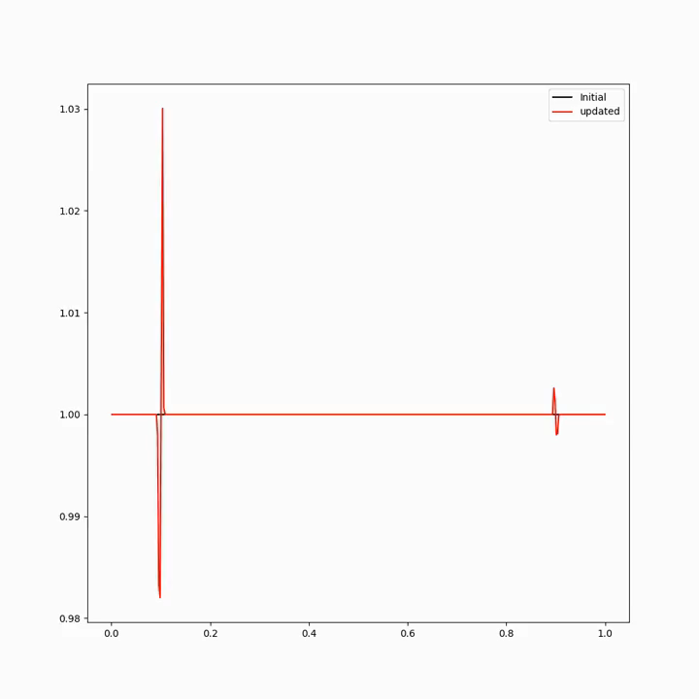
Blastwave Problem
This is the ultimate problem in one dimension which is used to test the quality of a numerical scheme.
Slowed down ~1000 times.

Slide 29
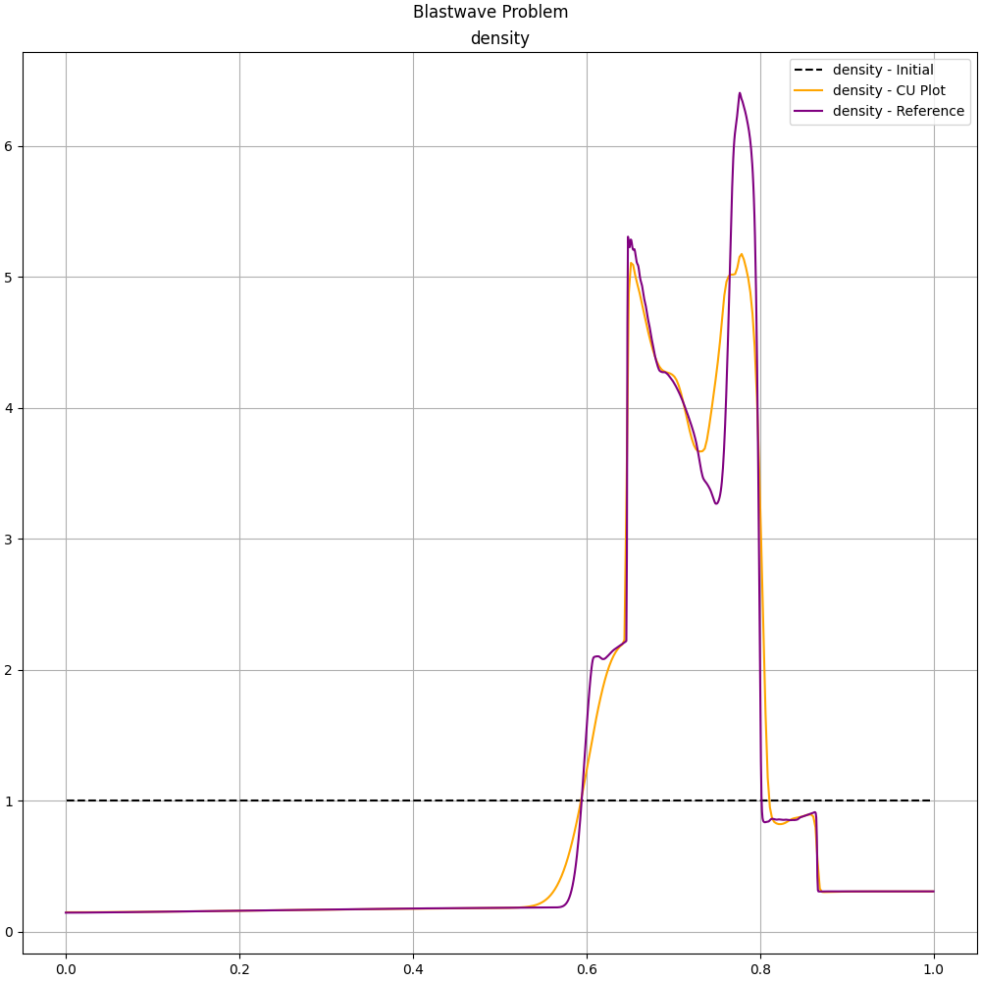
Blastwave Problem
This is the ultimate problem in one dimension which is used to test the quality of a numerical scheme.
Slowed down ~1000 times.

Slide 30
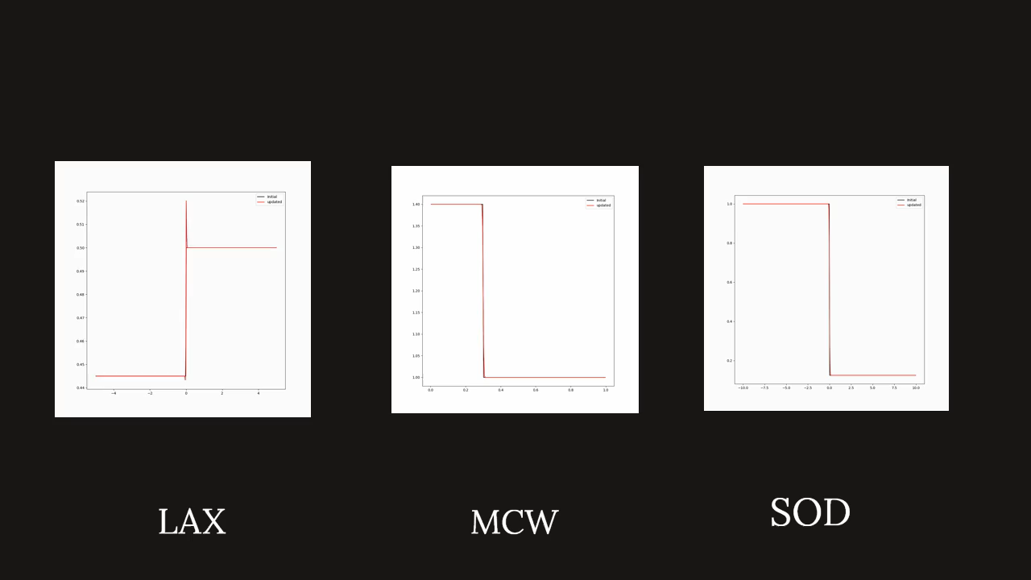
Some more examples

Slide 31
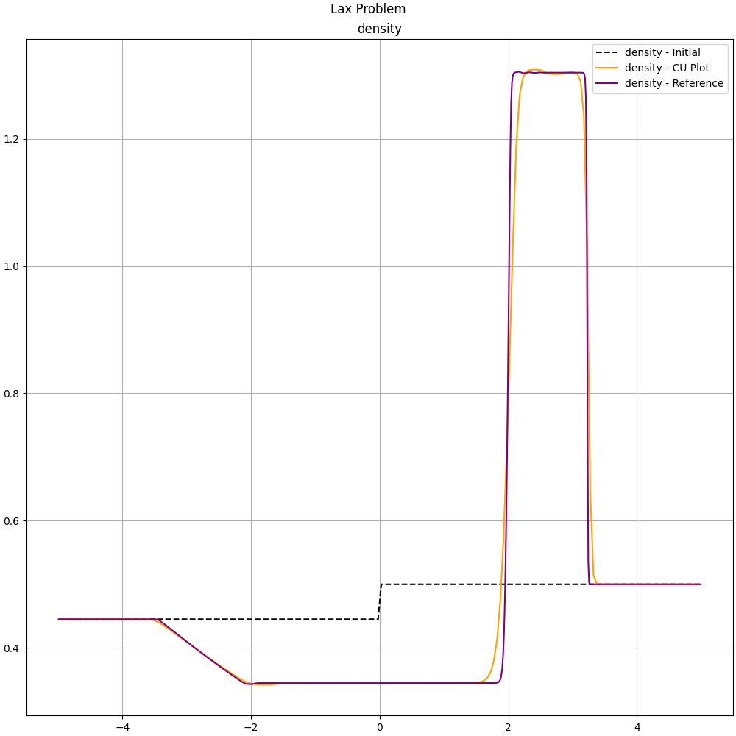
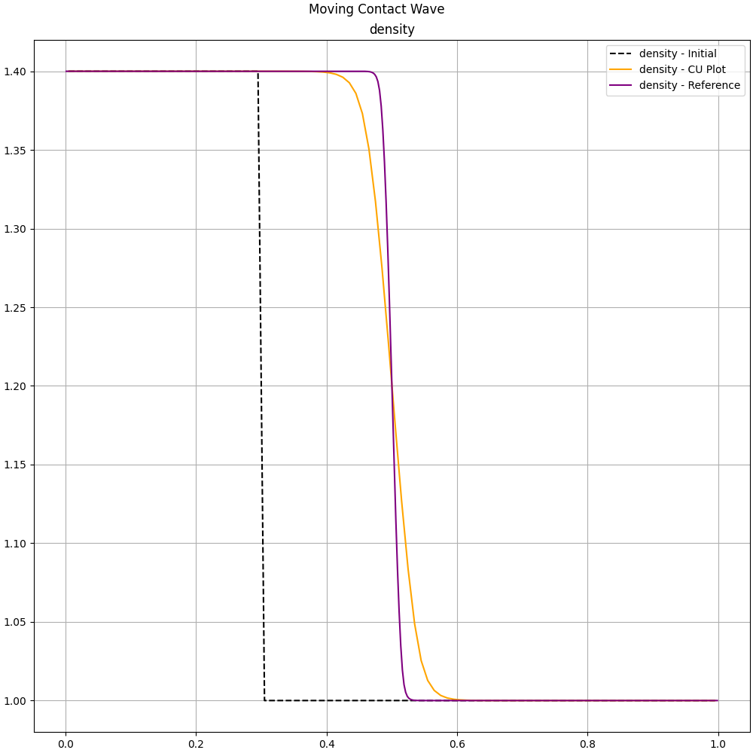
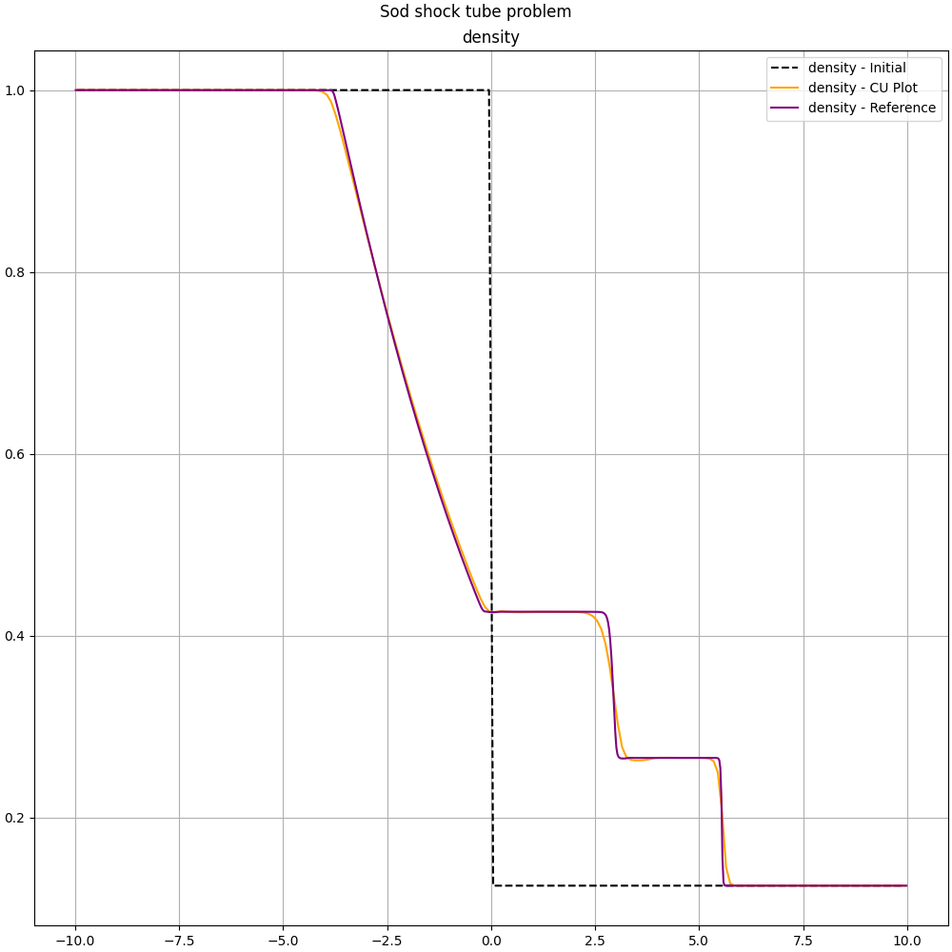
Some more examples

Slide 32
Future work
The present study was to gain foundational knowledge about hyperbolic conservation laws and finite volume schemes to solve them numerically.
More emphasis was given to coding already established schemes to get used to the methodology and scientific computing.
An immediate objective is to study and implement the CU scheme for two dimensions along with in-depth analysis including computational complexity, convergence and stability of the solutions.
The numerical schemes are highly parallelizable and thus one possible step in the future could be to improve the performance of the code with the help of high performance parallel computing.

Slide 33
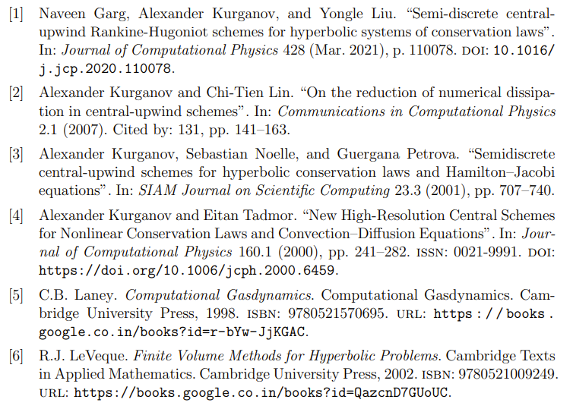
References

Slide 34
References
Thank You

